Slide 1
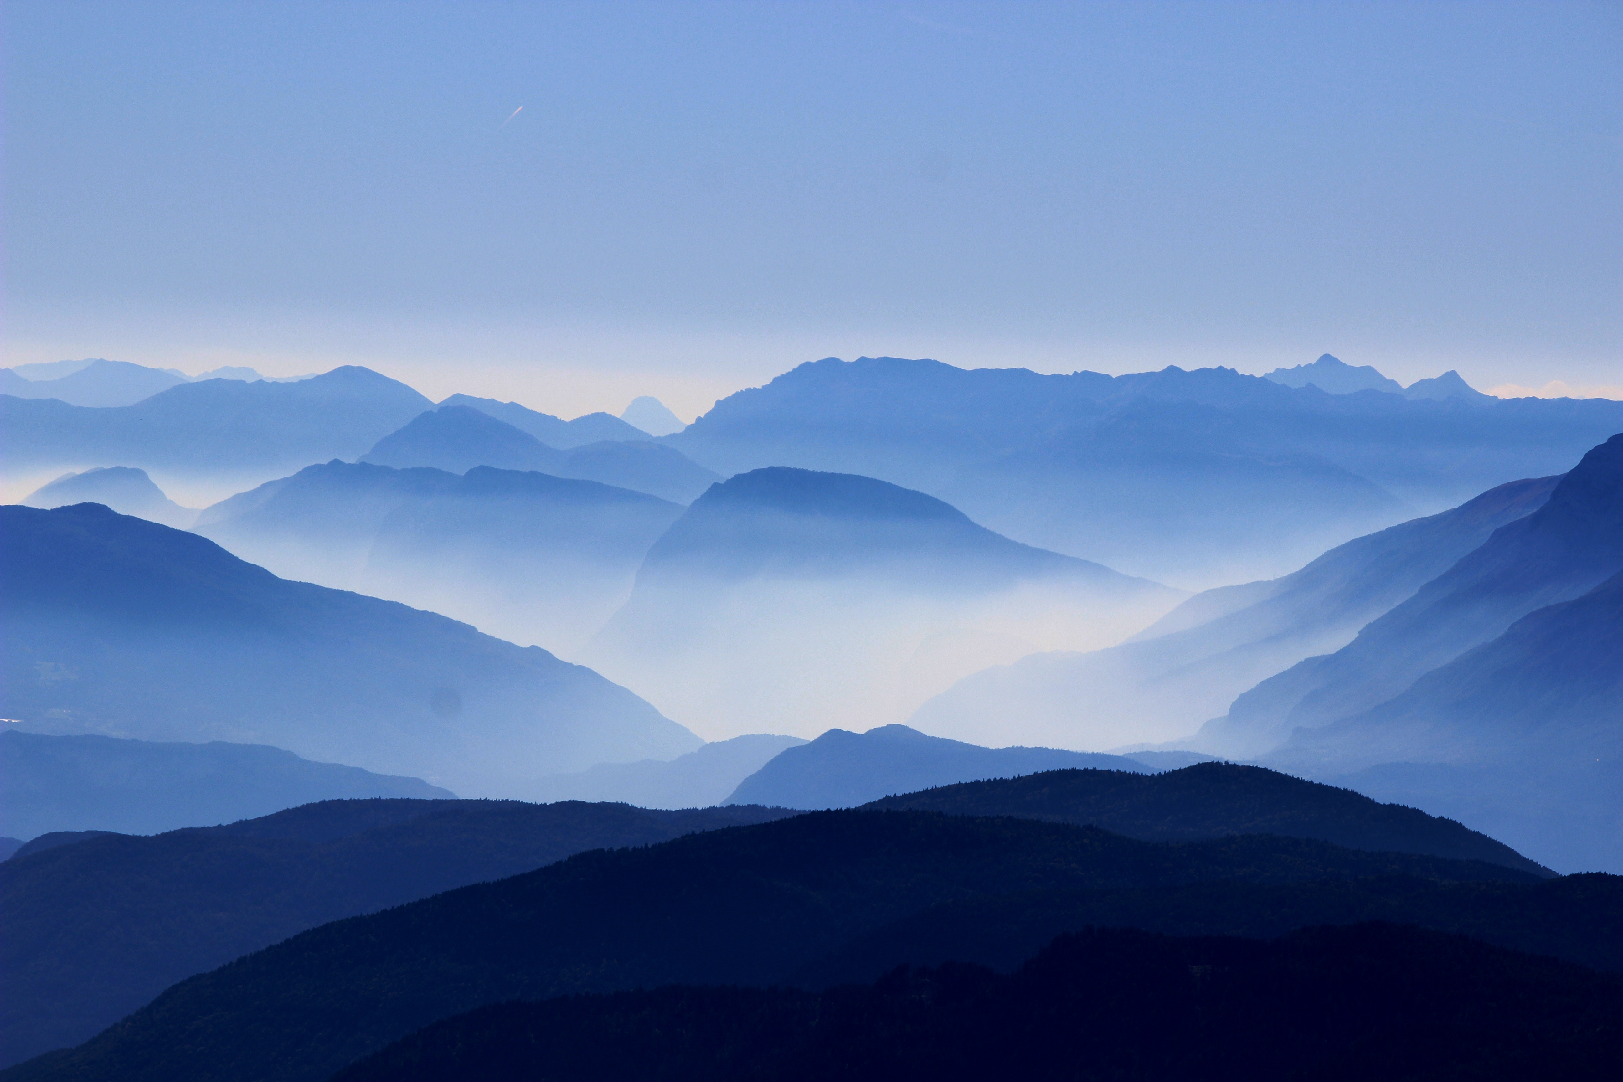
WELCOME TO
THE BLUE MOUNTAINS

